Slide 1

BMW APP
-Sameer Mulani (J026)

Slide 2
OBJECTIVE
To create an application that which will let the user explore different cars before purchasing.
It gives the user an insight on the models that are available for purchase.
User can reach out to the company via mail, instagram and call.

Slide 3
NAVIGATION TABS
HOME
CARS
CONTACT US
About BMW
Models categorized as SUV and Sedan
The user can reach out to the company via
Mail, instagram and call

Slide 4
CATEGORIES OF MODEL
SUV
Sports Utility Vehicle
6 models available
MODELS
SEDAN
7 models available

Slide 5
METHODOLOGY
Displays BMW logo while launching the app
Splash Screen
Home
Yet to be made
SUV and SEDAN, used spinner to load 2 fragments
Cars
Contact Us
Used implicit calling and web view

Slide 6
MODELS
Used Spinner to give user an option between SUV and Sedan. Fragment is loaded according to what the user choses.
In every fragment, there is a card view for each car model.
All the cards are scrollable

Slide 7
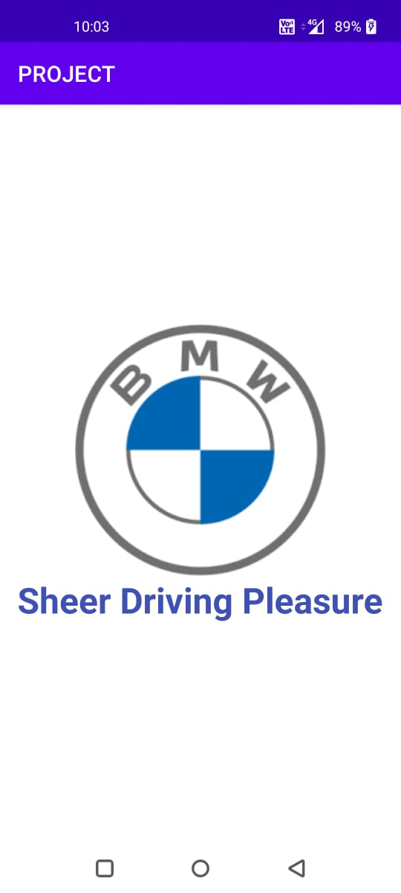
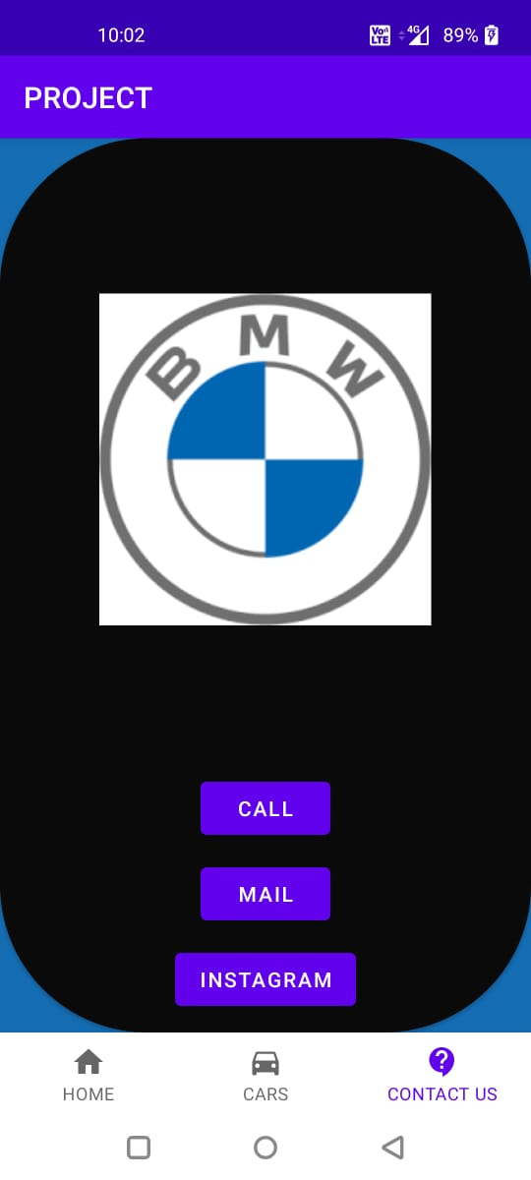
SPLASH SCREEN & CONTACT US

Slide 8
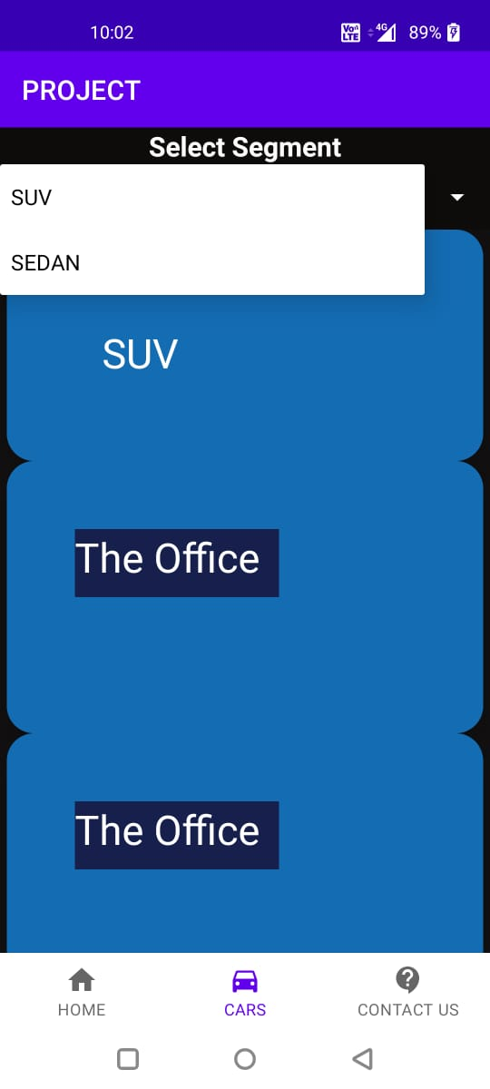

SUV & SEDAN

Slide 9
FUTURE WORK
Including a database, which will update the car information on real time basis.
Login Credentials.
Comparison between two or more cars.
Creating a better UI.
Cart

Slide 10
THANK YOU

